Slide 1
Azure PaaS / IaaS 的演進 @ Build 2016
小朱

Slide 2
Agenda
PaaS: Azure Functions
PaaS: Service Fabric
IaaS: VM Scale Set

Slide 3
Azure Functions

Slide 4



Azure Functions 是什麼
程式碼
Azure Functions
事件與資料

Slide 5
新浮水印要求 由儲存取得影像 套用浮水印 儲存新影像到儲存

Slide 6
新浮水印要求 由儲存取得影像 套用浮水印 儲存新影像到儲存

Slide 7
支援程式語言
第一類優先支援 (目前)
Node/JavaScript
C#
實驗性支援
F#
Python
PHP
Batch
Bash
PowerShell

Slide 8
支援繫結
類型 | 服務 | 觸發器 | 輸入 | 輸出
Schedule | Azure Functions | ✔
HTTP (REST or WebHook) | Azure Functions | ✔ |  | ✔
Blob Storage | Azure Storage | ✔ | ✔ | ✔
Queues | Azure Storage | ✔ |  | ✔
Tables | Azure Storage |  | ✔ | ✔
Tables | Azure Mobile Apps Easy Tables |  | ✔ | ✔
No-SQL DB | Azure DocumentDB |  | ✔ | ✔
Streams | Azure Event Hubs | ✔ |  | ✔
Push Notifications | Azure Notification Hubs |  |  | ✔

Slide 9
使用 App Service 建立具延展力的應用程式

Slide 10






應用
eCommerce
Digital Global Presence
Custom Apps
LOB
API / Services / ISV
應用服務
Web Apps
Mobile Apps
API Apps
Functions
完全的受管理平台
開發
企業級
無極限/自動
作業系統與框架
負載平衡
其他相關
語言與框架
優越的 DevOps
自助服務
其他相關
企業級 SLA
安全與法規符合
地端連結
其他相關

Slide 11
建置於 App Service
執行與現有的 App 代管計畫 (app hosting plan)
與現有 Web, Mobile, 與 API Apps 並存
可使用現有的 App Service ARM APIs 部署
App Service 的所有功能
持續部署
部署槽
遠端除錯
執行於隔離與專屬環境
App服務環境協助執行於專屬環境
執行於自己的 VNET，使用自己的前端與防火牆。

Slide 12
於App Service擴展
擴展到較大的 VM 以取得更多資源
使用簡單的滑動棒就可以擴展
設定自動擴展規則，在你還在睡覺時處理額外工作。

Slide 13


建置於擴展

Slide 14
Serverless

Slide 15
案例 0 的非動態運算

Slide 16
案例 0 的動態運算

Slide 17
0 對多的動態運算

Slide 18
動態代管計畫 (Dynamic Hosting Plan)
目前為有限度的提供
空間大小從 128MB 到 1536MB 不等。前 400k GB/秒免費。
每百萬次要求收費，前一百萬次要求免費。

Slide 19
Azure Functions 架構
Functions
執行期
Functions
程式化介面
輸入繫結
觸發程序
輸出繫結
App Service
App Hosting Plans

Slide 20
Azure Functions 是開源專案
執行期、入口以及範本全部都在 GitHub 找得到。
https://github.com/Azure/azure-webjobs-sdk
https://github.com/Azure/azure-webjobs-sdk-extensions
https://github.com/Azure/azure-webjobs-sdk-script
https://github.com/Azure/azure-webjobs-sdk-templates
https://github.com/ProjectKudu/WebJobsPortal
開放藍圖
優先使用新功能
優先權與速度的透通性
貢獻專案的方向
執行期會是可攜的 (Portable)
MIT License

Slide 21
即將到來的里程碑
四月
強化品質與穩定度
Logic App 連接器整合
五月
更多的指南與合作廠商
工具的強化 (更好的地端發展, VS/VS Code, CLI)

Slide 22
Service Fabric

Slide 23




微服務當道
持續演進的應用
更快發行功能與能量以回應客戶預期
建立與營運可擴展服務
1
4
Monitor + Learn
Plan
Development
Production
2
3
Release
Develop + Test

Slide 24


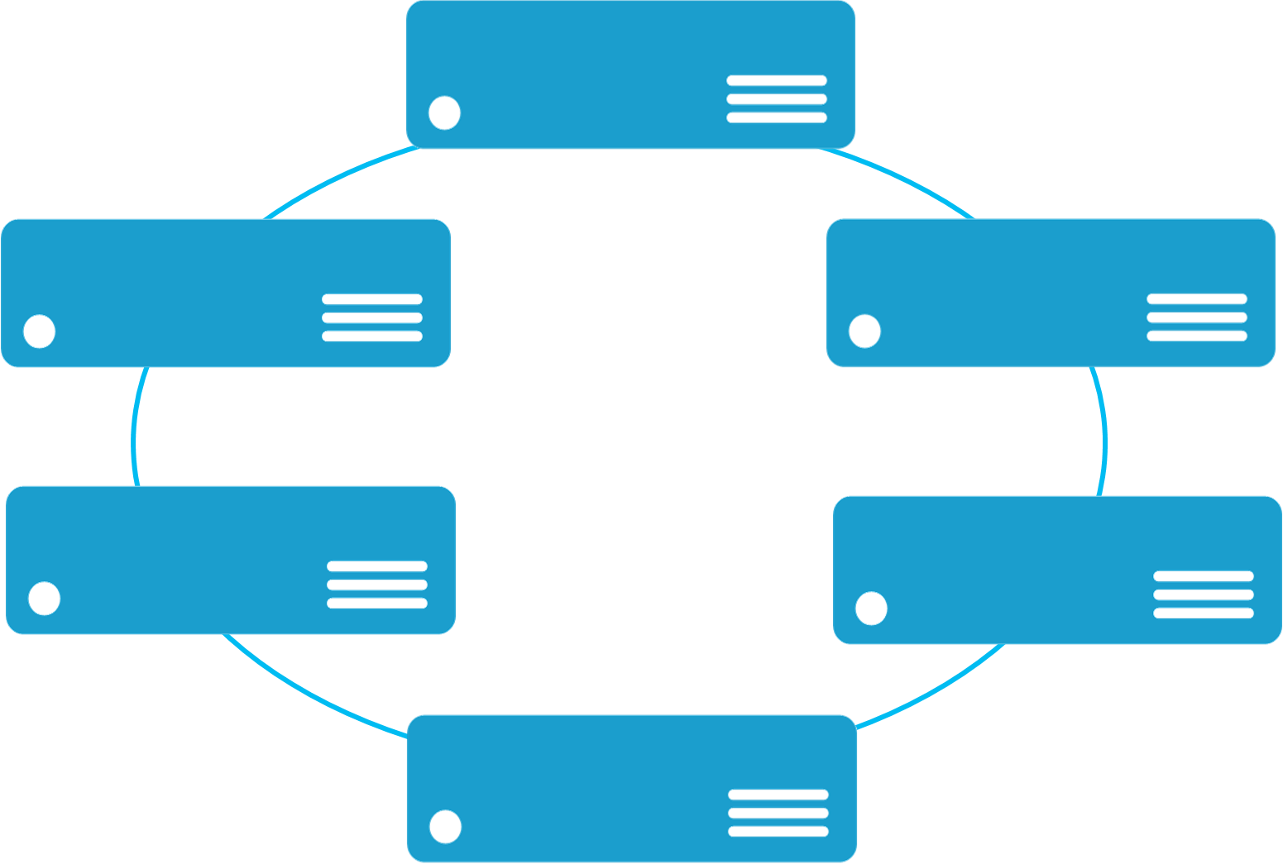


單體式應用程式 (Monolith App)
微服務應用程式 (Microservice App)
單體式應用包含領域指定的功能並且依功能層如 Web, Business, Data 來分層。
App 1
App 1
App 2
微服務應用程式將功能分割成數個較小的服務。
以在多個伺服器/VM/容器內複製應用程式來達到擴展能力
以跨伺服器/VM/容器部署為這些服務所建立的獨立個體來達到擴展能力

Slide 25
微服務
使用許多程式語言與框架建造應用程式
微服務平台
部署與管理應用程式到許多環境

Slide 26
Azure Service Fabric
生命週期管理
獨立擴展
獨立更新
總是可用
資源效率
狀態有無
公有雲
地端私有雲
其他雲

Slide 27

Service Fabric 叢集
資料中心 (Azure, 地端, 其他雲)
PC/VM #2
Service Fabric
你的程式碼資源
PC/VM #3
管理程式碼部署等 (Port: 19080)
Service Fabric
PC/VM #1
你的程式碼資源
Service Fabric
PC/VM #4
負載
平衡器
你的程式碼資源
Service Fabric
你的程式碼資源
PC/VM #5
App Web 要求 (Port: 80/443/?)
Service Fabric
你的程式碼資源

Slide 28
Service Fabric 競標應用程式
微服務設計
應用程式類型: sfAuction
服務類型: 網站 用戶可執行檔 (stateless) (Node.js)
服務類型: API閘道 可靠服務 (stateless) (C#/.NET)
服務類型: 競標 可靠集合 (stateful) (C#/.NET)

Slide 29
Action App in Azure
Cluster
VMSS #1 (無狀態層) NodeType=“FrontEnd”
VMSS #2 (有狀態層) NodeType=“BackEnd”
Node #1
Node #3
Website
Auction
負載
平衡器
ApiGateway
Node #2
Node #4
Website
Auction
ApiGateway

Slide 30
Service Fabric 平台能力
程式碼與程式化模型
快速部署
配置與活化
穩固性
高密度
健康回報
協調升級
Service Type: Website Guest Executable (stateless) (Node.js)

Slide 31
網站可執行檔與 Docker 容器 ServiceManifest.xml
<ServiceManifest Name="Pkg-Svc.Website" Version="1.0.0" …>
<ServiceTypes>
<StatelessServiceType ServiceTypeName="Svc.WebsiteType" UseImplicitHost="true"/>
</ServiceTypes>
<CodePackage Name="Code" Version="1.0.0">
<EntryPoint>
<ExeHost>
<Program>node.exe</Program>
<Arguments>Server.js</Arguments>
</ExeHost>
</EntryPoint>
</CodePackage>
</ServiceManifest>
<ContainerHost>
<ImageName>myNodeImage:latest</ImageName>
<Commands></Commands>
</ContainerHost>

Slide 32
Service Fabric 平台能力
程式碼與程式化模型
快速部署
配置與活化
穩固性
高密度
健康回報
協調升級
可靠服務程式化模型
服務端點探索
以實際資源使用為主的動態資源平衡
整合應用模式，例如Actor pattern 與 WebApi
Visual Studio 開發，例如 F5 除錯, 診斷事件, 封裝與部署
Service Type: Website Guest Executable (stateless) (Node.js)
Service Type: APIGateway Reliable Service (stateless) (C#/.NET)

Slide 33


狀態架構: 傳統與 Service Fabric
無狀態 Web
無狀態 運算
快取
狀態資料
其他內部層 ?
負載
平衡器
無狀態 Web
有狀態運算
負載
平衡器

Slide 34
Service Fabric Platform Capabilities
程式碼與程式化模型
快速部署
配置與活化
穩固性
高密度
健康回報
協調升級
可靠服務程式化模型
服務端點探索
以實際資源使用為主的動態資源平衡
整合應用模式，例如Actor pattern 與 WebApi
Visual Studio 開發，例如 F5 除錯, 診斷事件, 封裝與部署
可靠集合程式化模型
高可靠度與可擴展狀態
與外部儲存相較的低延遲
Service Type: Website Guest Executable (stateless) (Node.js)
Service Type: APIGateway Reliable Service (stateless) (C#/.NET)
Service Type: Auction Reliable Collections (stateful) (C#/.NET)

Slide 35
有狀態競標服務
競標 (分割區 #1)
Users Dictionary
Email | UserInfo
U1 | ItemId[]
U2 | ItemId[]
U1’s Items Dictionary
ItemId | ItemInfo
U1/“A” | 2016-2-1, Bid[]
U1/“B” | 2016-2-5, Bid[]
CreateUserAsync
APIGateway
Active Items List
ItemId
U1/“A”
U2/“X”
U2’s Items Dictionary
ItemId | ItemInfo
U2/“X” | 2016-3-3, Bid[]
U2/”Y” | 2016-4-9, Bid[]

Slide 36




















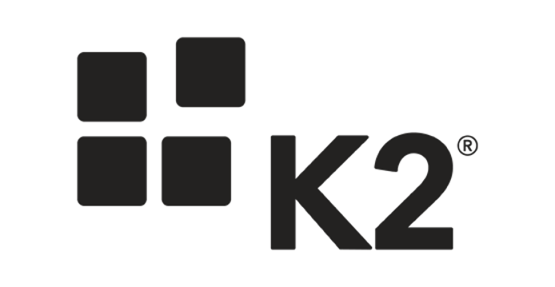
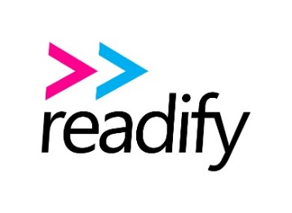









































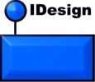










Slide 37

















Slide 38


Age of Ascent & Service Fabric
Ben Adams
CTO
Independent games studio specializing in massively multiplayer games

Slide 39


Ultra Massively Multiplayer Game
Driven by human interaction
A single contiguous universe
Without artificial boundaries
Credit: NASA, ESA, S. Beckwith (STScI), and The Hubble Heritage Team (STScI/AURA)

Slide 40
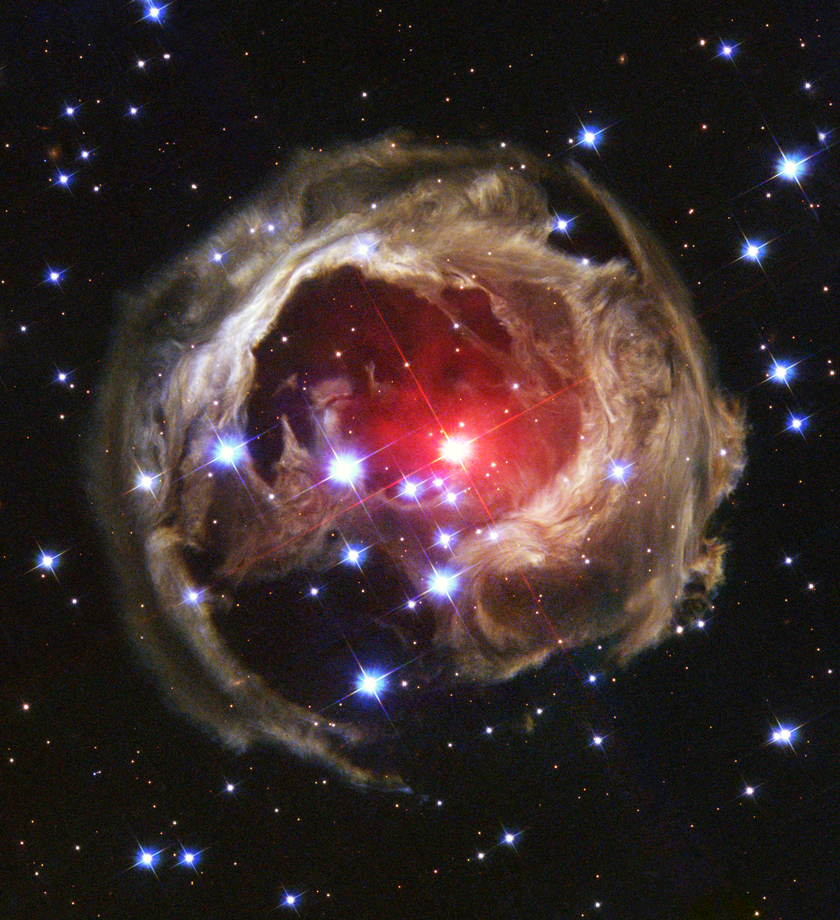
Born in the cloud
Servers are a resource
Hyper scale
High density
Cost effective
Unanticipated load handling
Fault tolerant
Seamless user experience
Always available
Individually upgradable
Data scales with compute
Credit: NASA and The Hubble Heritage Team (AURA/STScI)

Slide 41

High Performance
Empire building, economic price wars, real-time space twitch-combat.
Millions of players concurrently in single contiguous universe.
50,000+ simultaneous players, real-time in the same battle.
267 million networked application messages per second. (23 trillion per day)
Credit: ESO/L. Calçada

Slide 42


web browser
or device
Age of Ascent 架構
CDN
Service Fabric Cluster
Gaia (stateless)
Avatar
(stateless)
32 Microservices
AI
Events
routing
services
Age of Ascent
physics
service
Account
Player
Commerce
Crew
Alliance
aggregate
services
game
function
services
Spatial
(In Space)
Trade Inventory Production
Navigation
Comms

Slide 43
Azure Functions

Slide 44
The Azure Application Platform
Preview
GA
“App Creators”
Developers
Analysts
Build on Infrastructure
Build on Dev frameworks
Existing App Investments
Differentiation Time to value
Virtual Machines
VM ScaleSets
Container Service
Batch
Open Source PaaS
Service Fabric
App Service
Power Apps
Environments
Web/Mob/API
Logic
Stateful and stateless one-off solutions
Scalable solutions
Scalable, orchestrated Docker images deployed into containers
Custom High Performance Computing solutions
Custom Microservice-based stateless and stateful solutions
All the goodness of App Service in a dedicated environment
Template based rapid development web, mobile and API solutions
Orchestrated workflow based integration solutions
Graphical design mobile solutions
Cloud Foundry,
Open Shift
Lift & Shift
Docker
SaaS
LOB
Microsoft Azure

Slide 45
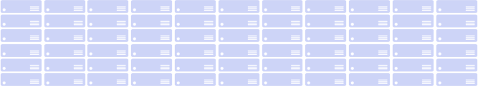
對 PaaS 的想像..
應用程式健康監控
自動擴展
管理服務而非伺服器
應用程式生命週期
自動 OS 更新
沒有供應商鎖定問題
封裝與部署
自訂插件
混合支援
高密度選項
自訂 OS 支援
Infrastructure Services
Compute
Storage
Network
Azure Global Datacenters

Slide 46
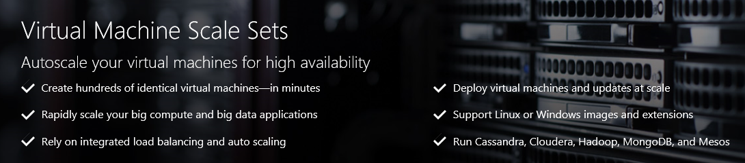
虛擬機器擴展集 GA
https://azure.microsoft.com/en-us/documentation/services/virtual-machines-scale-sets/
使用集合的概念部署與管理 VM
為 Azure 運算資源之一 Microsoft.Compute/virtualMachineScaleSets
與 Azure Autoscale 整合
與 Azure Load Balancer 整合
為 PaaS 打造，可擴展且平台獨立的基礎建設

Slide 47
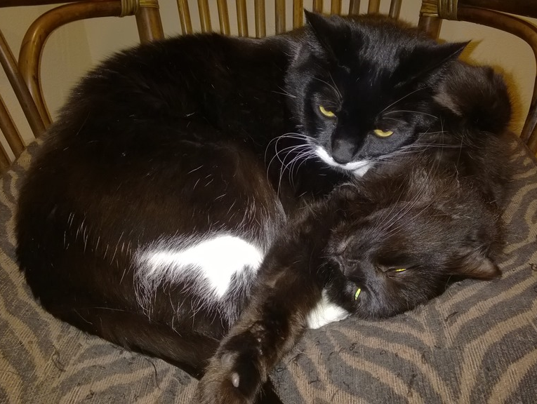
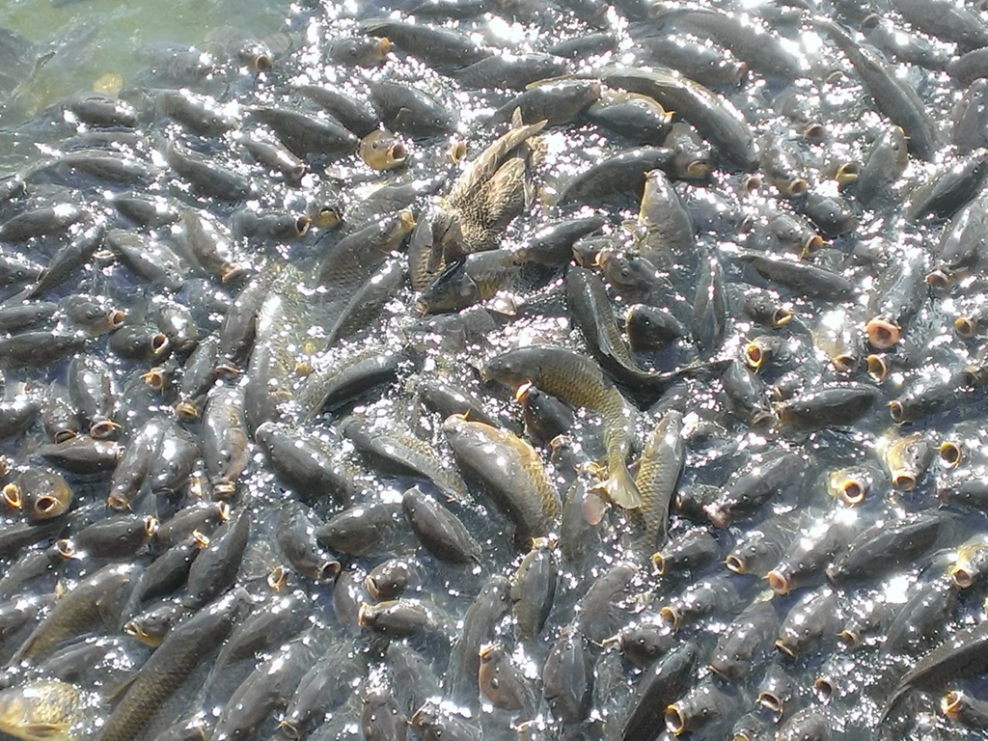
雲端可擴展模式
寵物：擁有唯一角色的具名資源。
家畜：已編號，本質上可取代或互換。
控制節點與代理人
不變性
自動擴展
“未來的應用程式架構應該使用家畜但具有強大組態管理的寵物是可行的而且也仍舊需要。” – Gavin McCance (CERN)

Slide 48
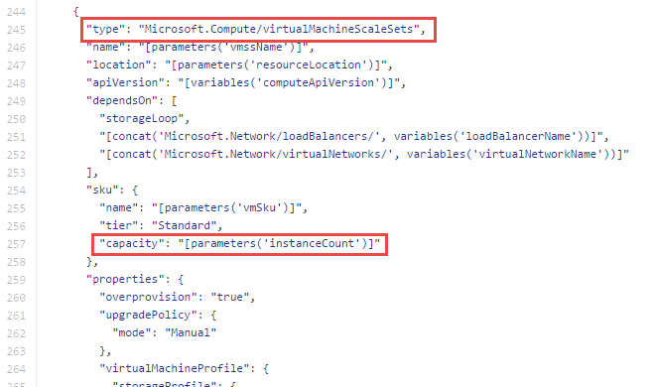
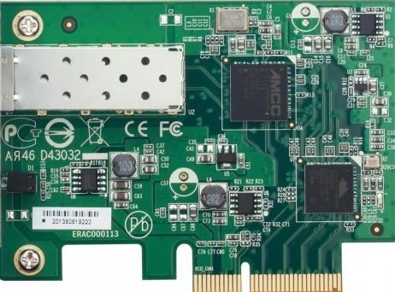

Azure 資源管理員內的 VM Scale Set
資源群組
Scale Set
Subnet
VM
VM
VM
VM
…
Scalable NIC
Scalable Storage
Extensions
VNET
https://github.com/Azure/azure-quickstart-templates - *vmss*

Slide 49
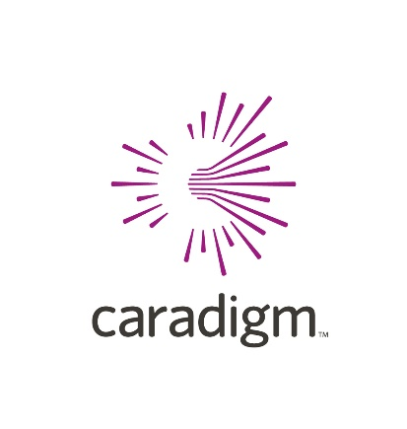



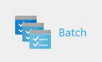



VM Scale Sets

Slide 50
應用開發

Slide 51
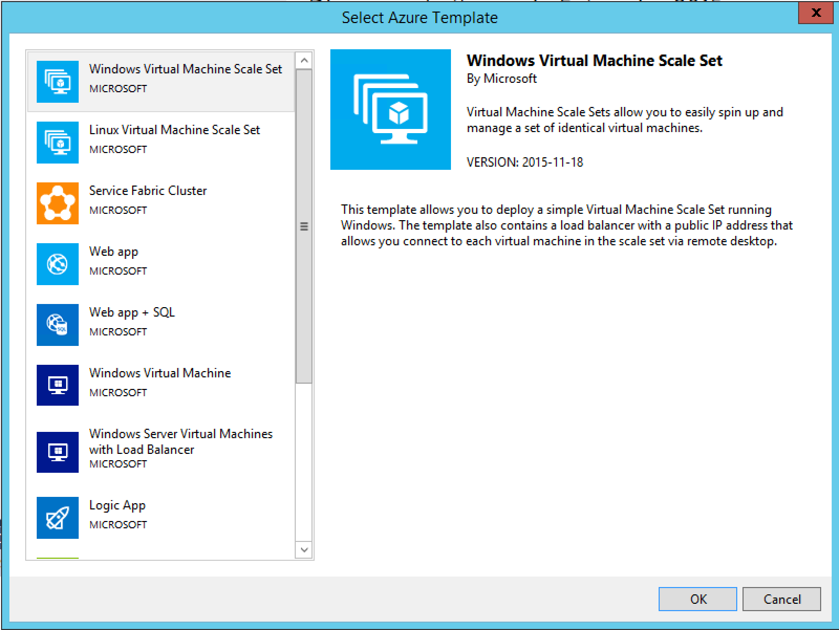
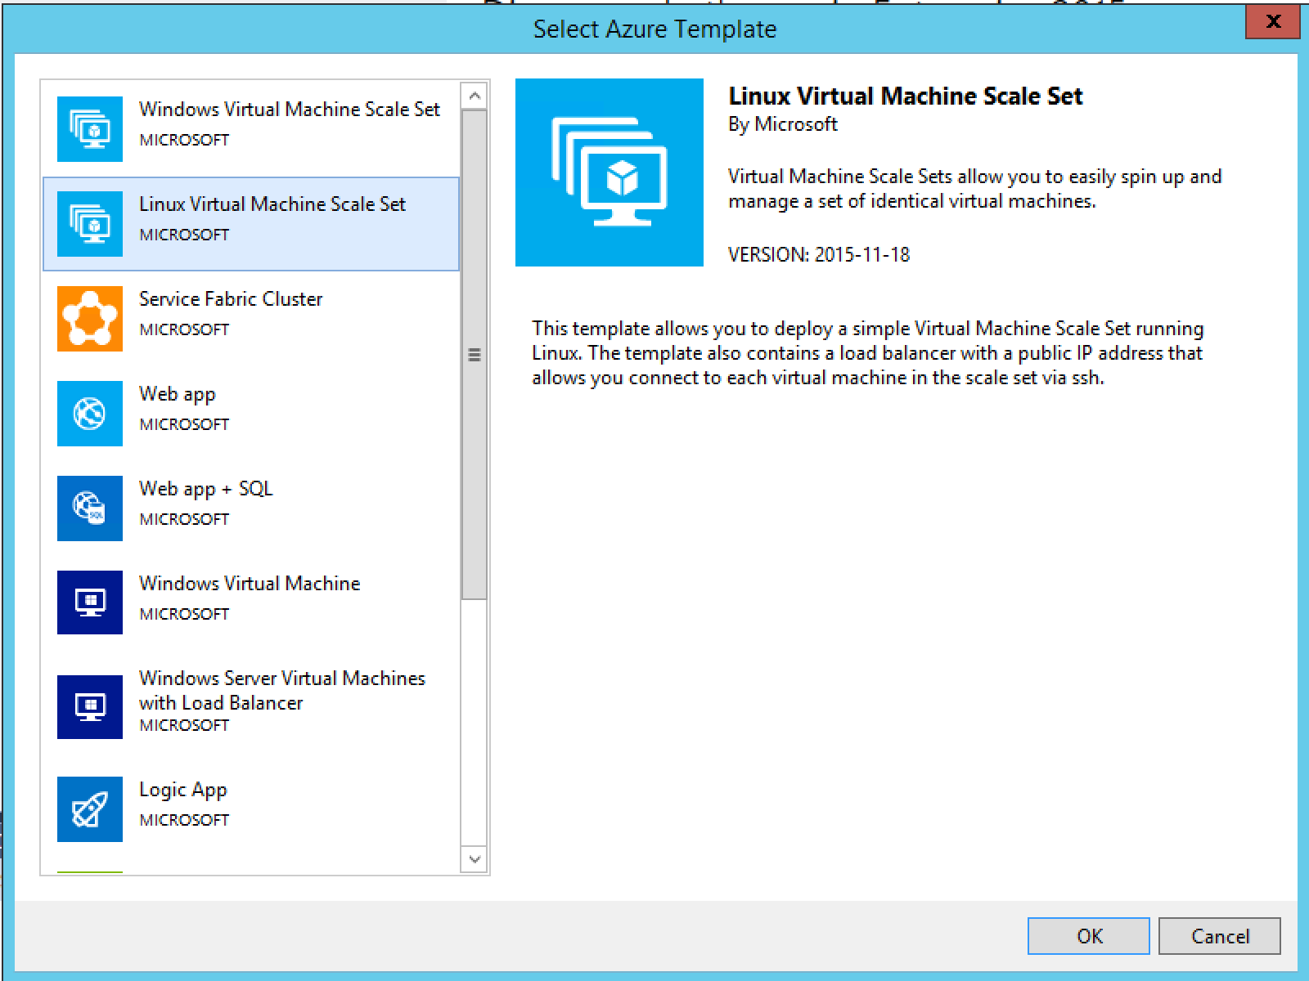
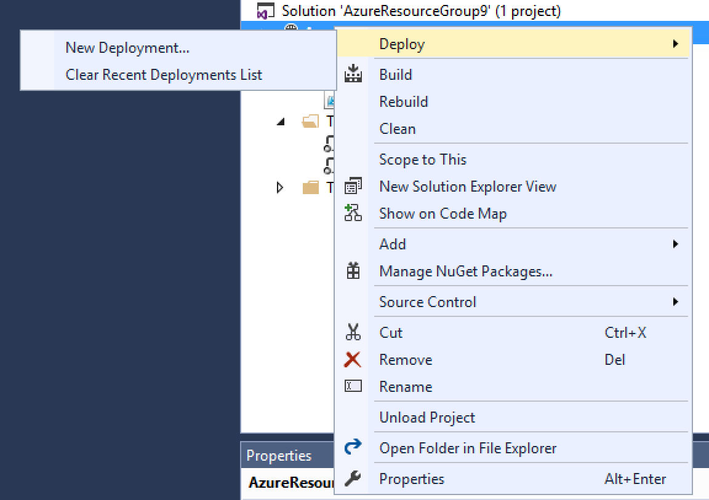
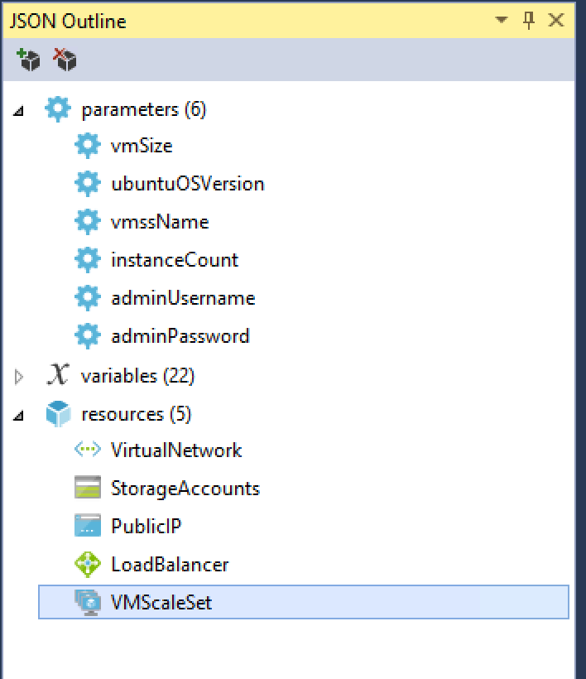
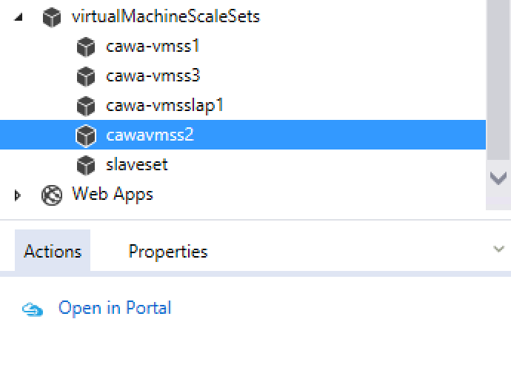
Using Visual Studio
Visual Studio 2013 or 2015
Azure SDK 2.7 or 2.8
https://azure.microsoft.com/en-us/documentation/articles/virtual-machines-vmss-vstemplates/

Slide 52
受管理的函式庫 / 命令列工具
供主要程式語言使用的 VMSS-ready SDKs:
.Net - https://github.com/Azure/azure-sdk-for-net
Java - https://github.com/Azure/azure-sdk-for-java/
Python - https://github.com/Azure/azure-sdk-for-python
Go - https://github.com/Azure/azure-sdk-for-go
Ruby - https://github.com/Azure/azure-sdk-for-ruby
Node.js - https://github.com/Azure/azure-sdk-for-node
使用 PowerShell
https://github.com/Azure/azure-powershell/releases/tag/v1.3.0-March2016
使用 CLI
https://www.npmjs.com/package/azure-cli

Slide 53
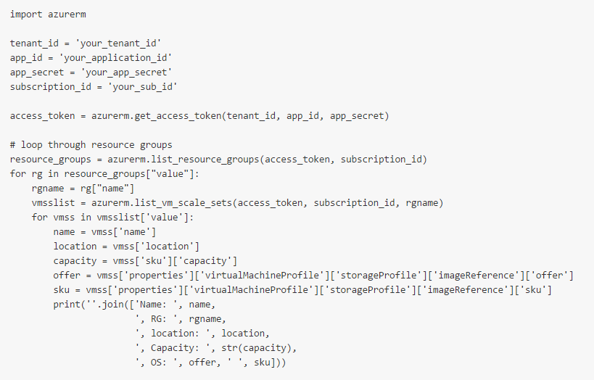
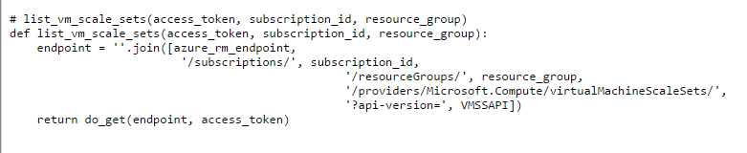
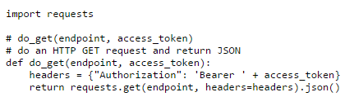
產生 REST 呼叫
已發行的 REST API: https://msdn.microsoft.com/en-us/library/azure/mt589023.aspx
例如.. Python..
New GA API version: 2016-03-30

Slide 54
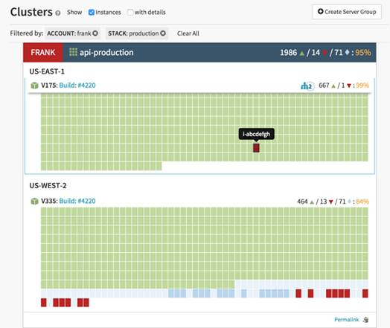
使用 VMSS 來發展開放的 PaaS 基礎建設
管理擴展
設定自動擴展
管理修補與映像更新
應用程式部署
實作不變性的部署管道

Slide 55
管理擴展
使用簡單的 REST 呼叫進行擴張與縮小的擴展
能力可設定 0 – 100
VM 會跨錯誤/更新域進行平衡
跨儲存帳戶的平衡
負載平衡器整合
新的 2016-03-30 API: overprovisioning
{
"sku": {
"name":"Standard_D1_v2",
"tier":"Standard",
"capacity":"50"
}
}

Slide 56

VMSS 作為擴展單元- 例子: Azure Batch
Batch pool
Batch pool: a logical abstraction over VM scale sets tailored to batch computing scenarios
Public IP
Public IP
Public IP
Load
Balancer
Load
Balancer
Load
Balancer
...
Scale Set
Scale Set
Scale Set
Larger units than a single VM make for more manageable coordination pieces
Storage AC
Storage AC
Storage AC
VNET
VNET
VNET
https://github.com/Azure/azure-quickstart-templates/tree/master/301-multi-vmss-linux
https://github.com/Azure/azure-quickstart-templates/tree/master/301-multi-vmss-windows

Slide 57
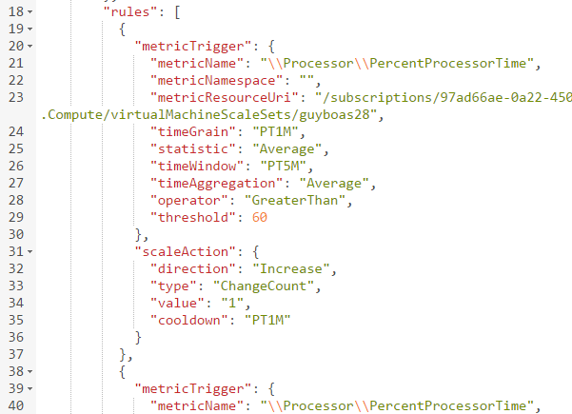
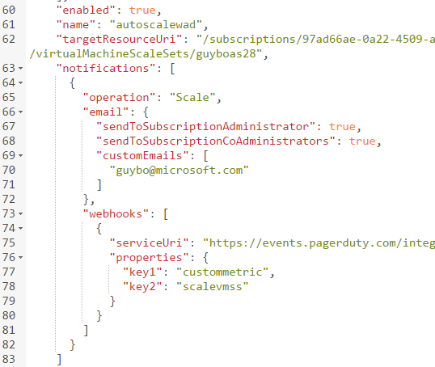
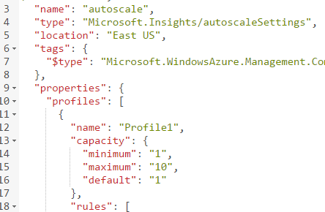
VM Scale Sets 的 AutoScale
定義最大-最小的 VM 數
定義觸發器：動作規則
標準稽核/Email 通知。
定義 WebHook 以處理自訂通知與動作 (例如 runbooks)

Slide 58
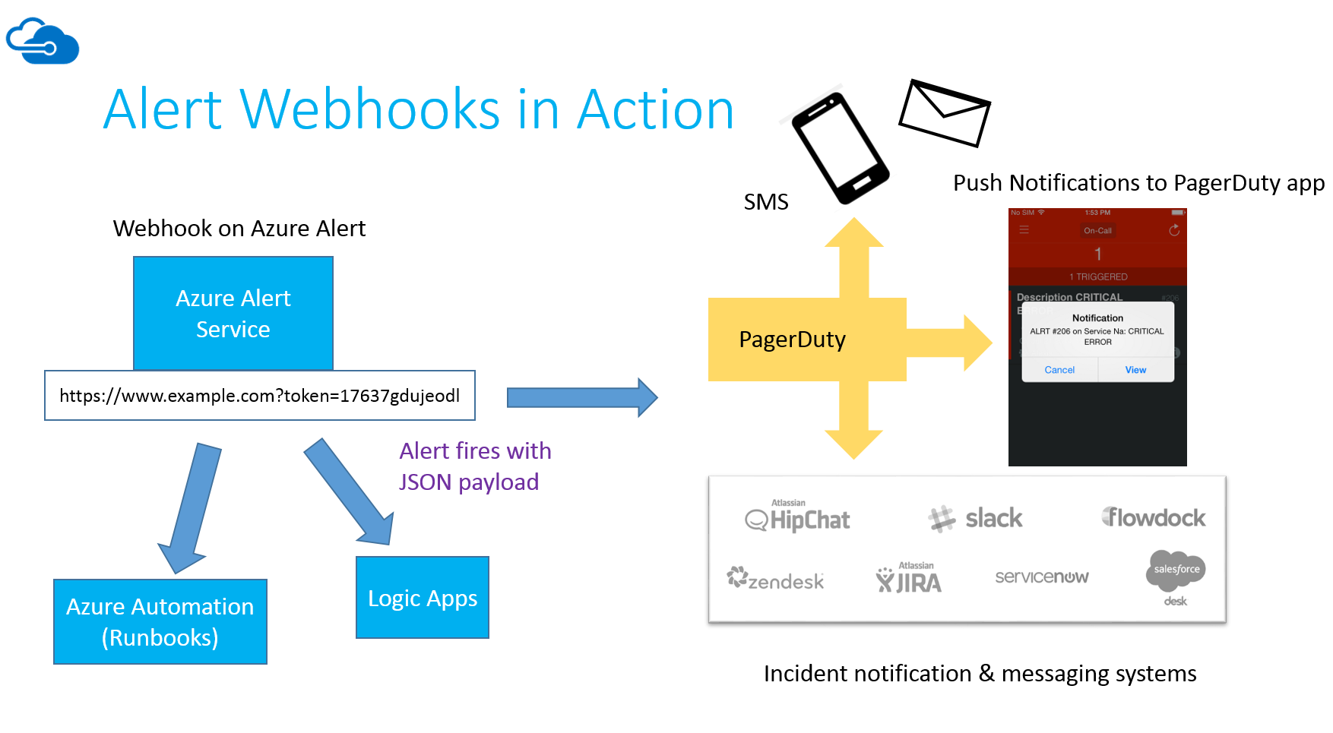
Alerts & Autoscale notifications with PagerDuty

Slide 59
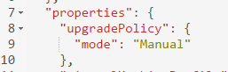
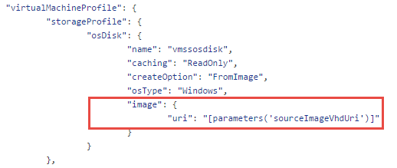
管理更新
應用程式更新
E.g. Chef/Puppet/container based
容器內更新
E.g. Patch extension
VM 映像更新
更新模式
upgradePolicy setting
升級節點
manualUpgrade API
重設節點
Reimage API
Update-AzureRmVmssInstance -ResourceGroupName $rgname -VMScaleSetName $vmssName -InstanceId "0"

Slide 60
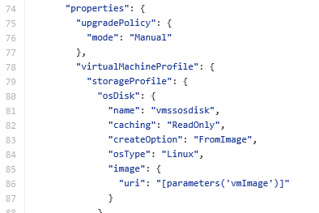
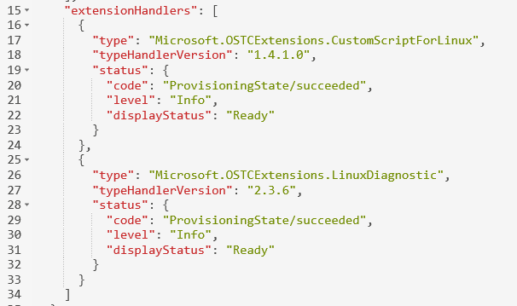
應用程式部署
預定義的客製 OS 映像
使用 VM 擴充的執行期部署
較高階的叢集管理 / 容器服務 / 組態管理員 (Chef/Puppet)

Slide 61




Azure Spinnaker : 工具鏈
Trigger Build
Trigger pipeline
Promote to Prod
Dev checks in code
Orchestrate across stages
Azure VM Scale Set

Slide 62

Azure Spinnaker : 不變性
Trigger Build
Trigger Immutable pipeline
Promote to Prod
Dev checks in code
Bake app into image
Orchestrate across stages
Production
Reuse the same image to create VMs across stages

Slide 63
Azure Spinnaker: What’s next?
零停機部署
容易回溯
單鍵起始
For more info, contact azspinnaker@microsoft.com

Slide 64
Cloud Foundry on Azure : 完全整合的 Azure Open Source PaaS 平台

Slide 65
Overview
Cloud Foundry : What & Why?
Azure support for Cloud Foundry
Deploy on Azure & Automation
Using Azure Services with CF
Contributing Code
Q&A

Slide 66
Cloud Foundry
What is CF?
Why CF on Azure?
Cloud Foundry is a open source PaaS that supports multiple languages
http://github.com/cloudfoundry
http://cloudfoundry.org
Can be run on public or private cloud
IaaS agnostic; Azure, AWS, OpenStack, vSphere, others
Openness, support for Java/Linux
Support for Windows and .NET
Rich Integration with Azure Services.
Azure Stack Support for Cloud Foundry (coming soon)

Slide 67

Cloud Foundry on Azure : Overview
- Generally Available and fully supported on Azure.
- Available via Azure Marketplace
Cloud Foundry
www.pivotal.io/microsoft.

Slide 68
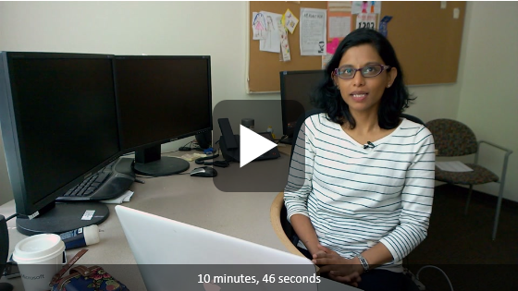
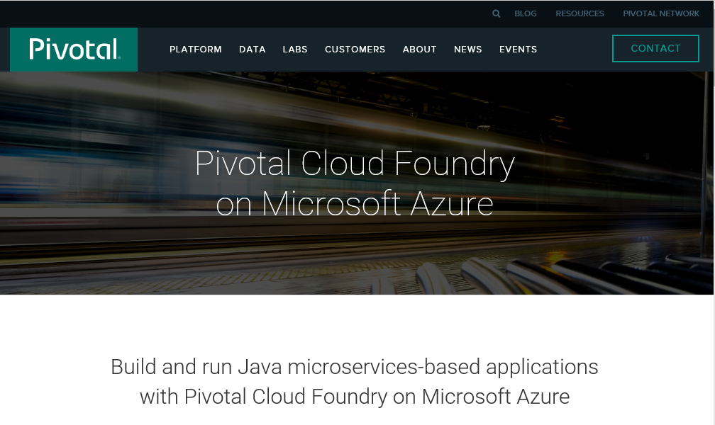
Azure Cloud Foundry Journey : The last one year
May 2015, Preview launch of CF
March 2016, PCF on Azure

Slide 69
Azure Cloud Foundry Goals
Ship an all Open Source Project
Project URL : https://github.com/cloudfoundry-incubator/bosh-azure-cpi-release
Provide consistent experience with all Cloud Providers.
Align with Community’s engineering practices.
Provide first party experience with deep Azure Integration
Provide Resource Template, automate Azure Environnent setup
Azure Stack support for true Hybrid Cloud deployment
Integration with Azure first party services like SQL, Service Bus, Storage etc.
Ongoing support with a Committed Roadmap
Standard CF functionality is supported by community
Azure specific features supported by MS
Committed Long term roadmap for further Azure integration

Slide 70




Cloud Foundry on Azure
BOSH = CF Bootstrapper
Azure Templates
Push App
Applications
> cf
BOSH
http://
Azure Interface
Infrastructure Services
Compute
Storage
Network
Azure Global Datacenters
Microsoft Azure
Public, Global, Shared Datacenters

Slide 71
Pivotal Cloud Foundry on Azure :

Slide 72
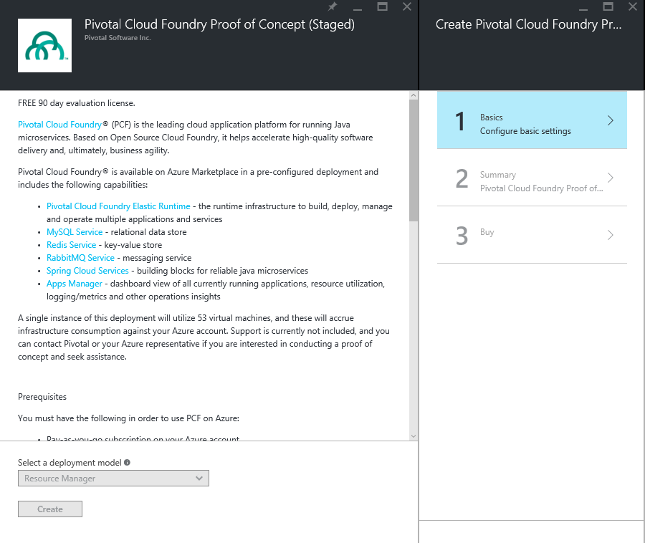
Pivotal Cloud Foundry on Azure
The company behind CF.
PCF on Azure built using the open source components.
Single Click deploy using Azure Template which Deploys:
53 VMs
Elastic Runtime
MYSQL
Redis
RabbitMQ
Spring Cloud Services
Built in capabilities from deploying Spring applications.

Slide 73



Developers focus on generating value for customers
Pivotal Cloud Foundry integrated with Azure Platform Services available in the Azure Marketplace
Agile Development
Accelerate App creation
20+ years of Agile experience
16 Labs worldwide
Pivotal Cloud Foundry Platform Runtime
Service Discovery
Container Scheduling
#1 Java App Framework
#1 Microservices Framework
#1 Cloud Framework
Routing
Configuration
Pivotal Application Services
+
Azure Platform Services
Microservices Application Framework :: Spring Boot, .Net, Ruby, , Go
Infrastructure Independent
Open Source Software
Rapidly grown partner ecosystem
Logging & Metrics
Messaging
Pivotal Cloud Foundry Operations
Platform Services
Services Compute
Web & Mobile
Data
Security &
Management
Integration
Hybrid
Operations
Developer Services
Analytics & IOT
High value application & data services built in
Global presence
Pay for what you consume
Media & CDN
Infrastructure Services
OS/Server
Compute
Storage
Networking
Azure Datacenter Infrastructure

Slide 74
Cloud Foundry + Azure Services

Slide 75
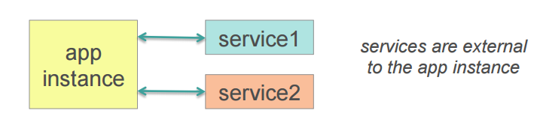
Cloud Foundry Service Brokers
Service Broker:
Enables developers to discover and integrate their CF applications with other Services.
A service is an external application dependency or component such as:
External state; database, cache, message queue
Tools; monitoring app, external logging sink, OAuth security
cf marketplace
service plans description
azurestorageblob default* Provides Azure Storage Service, including storage account creation, container creation, access key generation
p-mysql 100mb-dev MySQL service for application development and testing
cf create-service myAzureStorageService
//create a service instance
cf bind-service myApp myAzureStorageService
// bind service to my app
cf restage myApp
// restart my app

Slide 76
Demo app : Azure Storage Service Broker & Azure Storage consumer
Azure Storage Broker:
Provision : Create Storage account
Bind : Provide storage information as Environment variables

Slide 77
Contributing Code :
Azure CPI Github Branch:
https://github.com/cloudfoundry-incubator/bosh-azure-cpi-release
Azure Service Broker Branch
- Coming soon (in final review)!

Slide 78
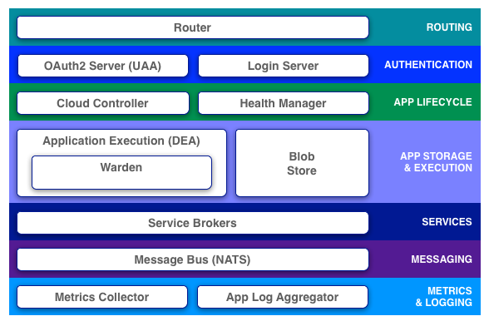
Cloud Foundry-Azure Integration – Asks from customers
Cloud Foundry
Azure
Azure Application Gateway
Azure Active Directory
Azure Encryption, Azure Security Center
Application
Azure Blob Storage
Azure SQL, KeyVault, ServiceBus, EventHub…
Operations Manager Suite

Slide 79
PCF on Azure Roadmap
2013
June 2015
Nov 2015
Nov 2015
March 2016
August 2016
PCF 1.0
Founding of Pivotal,
1st release of Pivotal Cloud Foundry
PCF 1.5
Enable Windows stack for .NET support as BETA
PCF 1.6
GA for .NET on PCF
Open Source CF GA
Early access to MSFT Azure CPI via Pivotal for select customers
“PREVIEW” PCF on Azure
PCF on Azure installation managed by Pivotal for free
“GAMMA”
Basic PCF deployable through Azure Marketplace
PCF “GA” on Azure
Azure Managed Disk, Application Gateway,
Operations Manager,
Service Brokers,
Windows Agent for BOSH

Slide 80
Cloud Foundry Support
Open Source CF
Pivotal (PCF)
CPI supported through standard Microsoft Support processes
Open ticket through MSDN, etc…
See blog for GA guidance on deployment
Pivotal licenses provide support for Cloud Foundry
Pivotal requires customers to have a support contract with their IaaS provider
Pivotal assistance required for deployment during “Preview” phase

Slide 81
Call to Action
Virtual Machine Scale Sets: https://azure.microsoft.com/en-us/services/virtual-machine-scale-sets/
VMSS docs: https://azure.microsoft.com/en-us/documentation/services/virtual-machine-scale-sets
Webhook for Alerts: https://azure.microsoft.com/en-us/blog/webhooks-for-azure-alerts/ ​
Azure Alerts & PagerDuty Integration: https://www.pagerduty.com/docs/guides/azure-integration-guide/
Cloud Foundry: https://github.com/cloudfoundry-incubator/bosh-azure-cpi-release

